Slide 1

Simulating Solar Energy Versus Grid Energy Costs

Slide 2

Problem Statement
The project aims to evaluate the long-term cost-effectiveness of solar panel systems compared to traditional grid systems for residential energy supply over a 20-year period.
Key metrics include cumulative costs, variability in energy demand, and the impact of financial factors such as installation costs, interest rates, and energy tariffs.

Slide 3
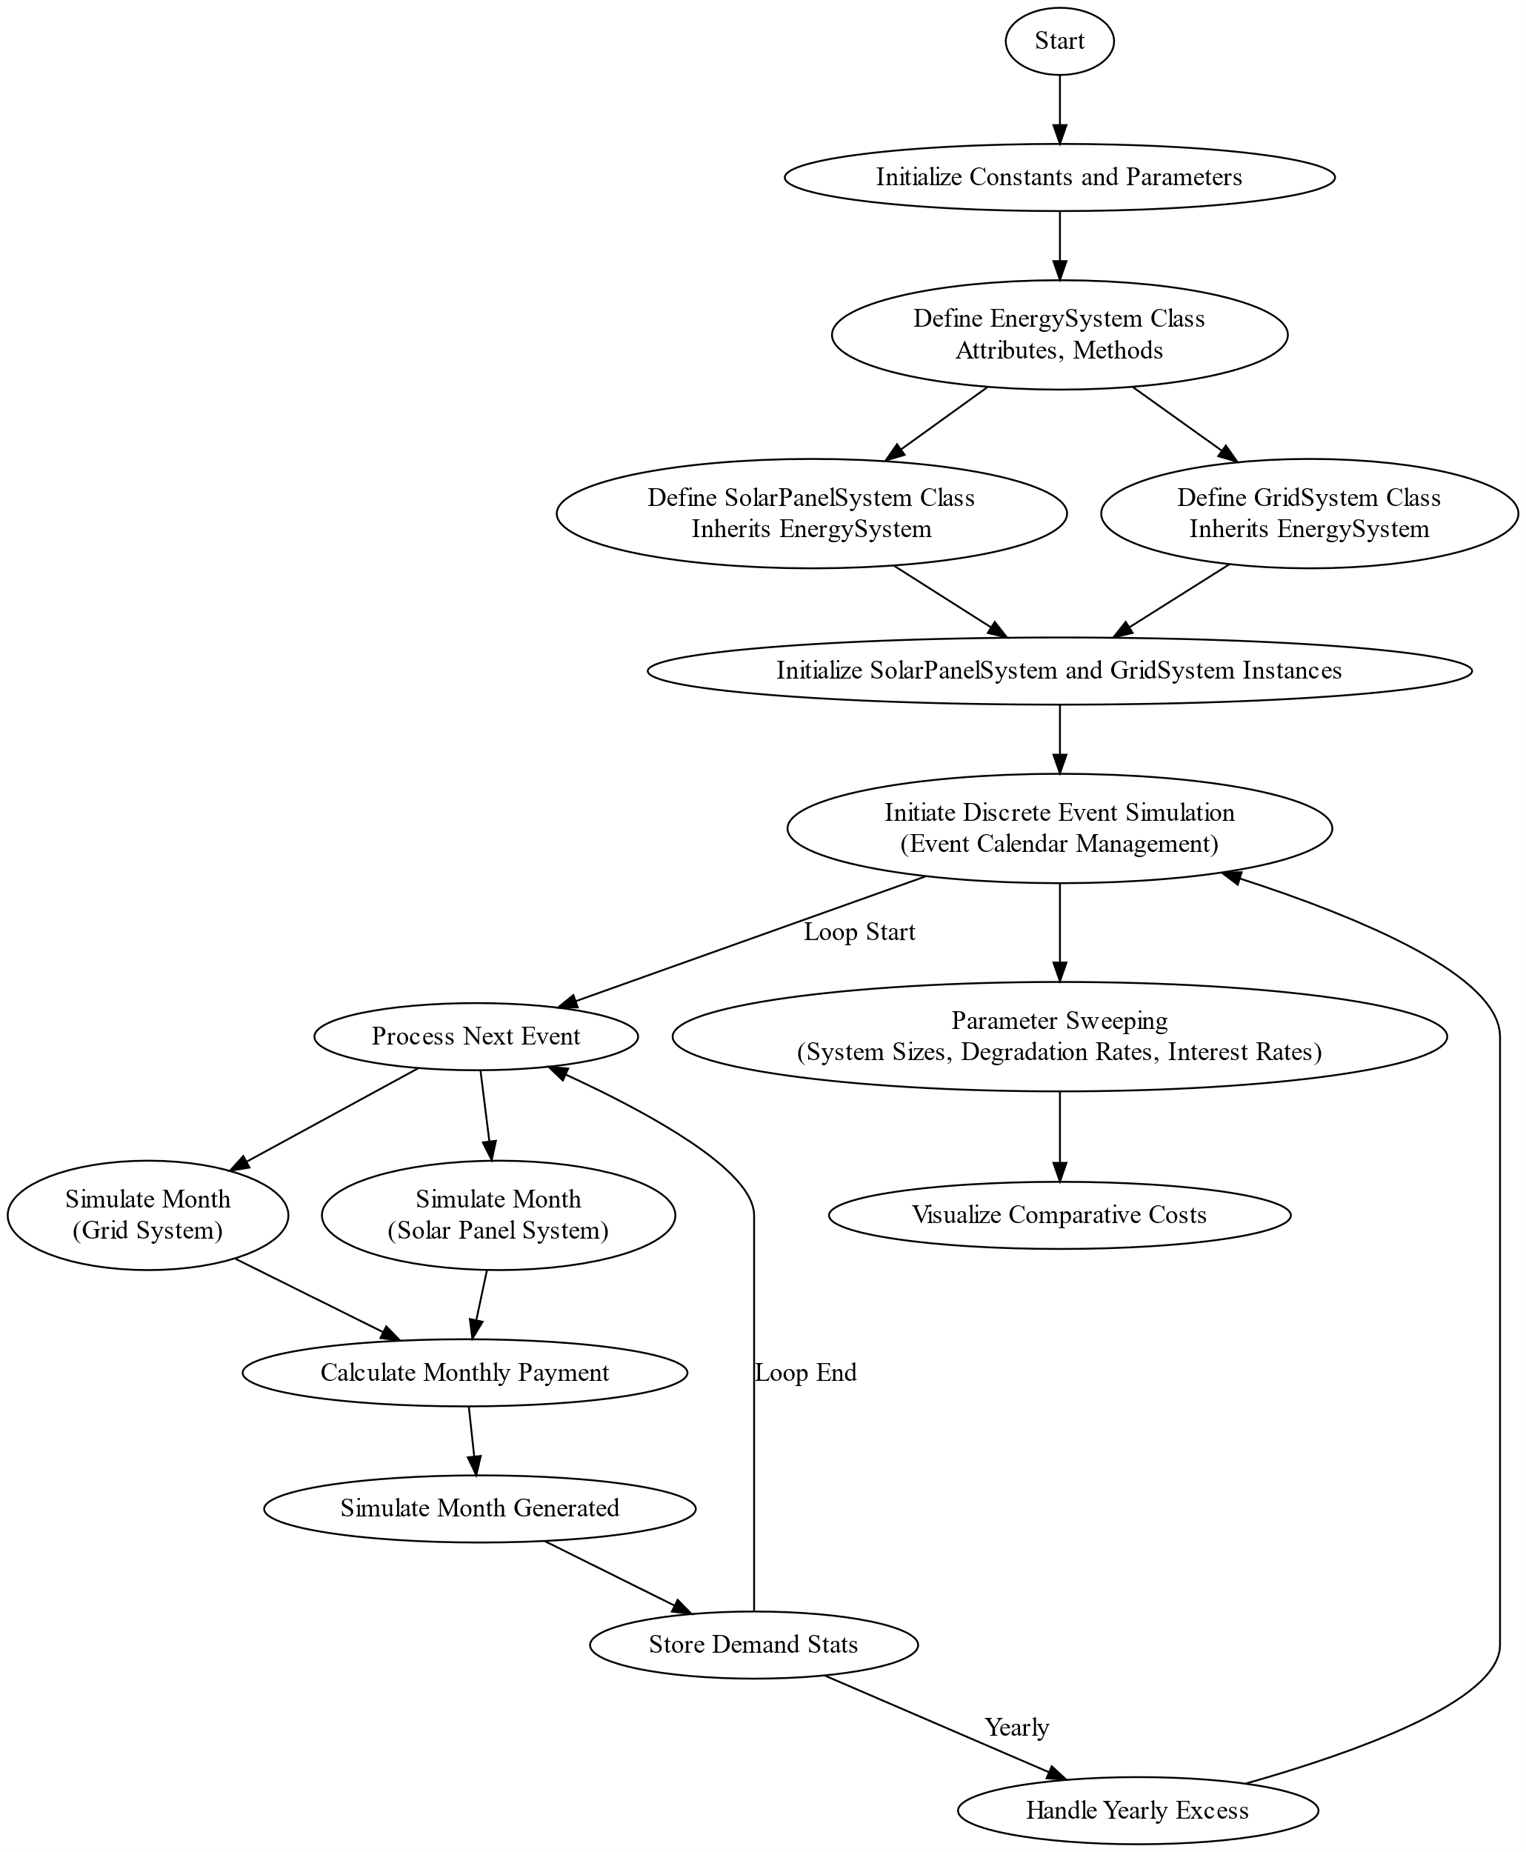
Flowchart

Slide 4
Methodology
Implemented using Python
Predefined variables and Assumptions
Installation Costs ($3,000 per KW)
Monthly Energy Usage Patterns (NYC)
Electricity Rates (NYC)
Electricity Rate Increases (1.7% Annually)
ConEd Monthly Charges
Normal Distribution for Daily Energy Usage
Used Classes to create the simulation
Used NumPy for Numerical Computation
Use Matplotlib and Seaborn for Visualization

Slide 5
Class Structure
EnergySystem
SolarPowerSystem
GidSystem
Base class encapsulating common functionalities and data structures for both SolarPanelSystem and GridSystem.
Handles simulations specific to solar panel installations, including degradation rates, tax credits, and payment methods (outright purchase or financed).
Simulates energy consumption based on local electricity rates and monthly usage patterns, without considering energy generation.

Slide 6
Description of Solar Panel System Class:
Installation Costs and Credits: Initial costs are calculated based on the system size (in kW) multiplied by the cost per kW. Federal and state tax credits are applied to reduce the upfront cost.
Payment Methods (Financed vs. Outright): Users can choose between financing the system over a specified period with interest or paying outright.
Handling of Excess Energy (Payout Method): Excess energy generated is either paid out at a reduced rate, rolled over to future months, or reset to zero annually.

Slide 7
Description of Grid System Class:
Simulation of Monthly Energy Usage: Utilizes historical monthly usage data and daily variability to estimate monthly energy costs based on local electricity rates.
Calculation of Monthly Costs based on Usage Rates: Monthly energy costs are calculated by multiplying the energy consumption by the respective electricity rates for each month.

Slide 8

Parameter Sweeps

Slide 9
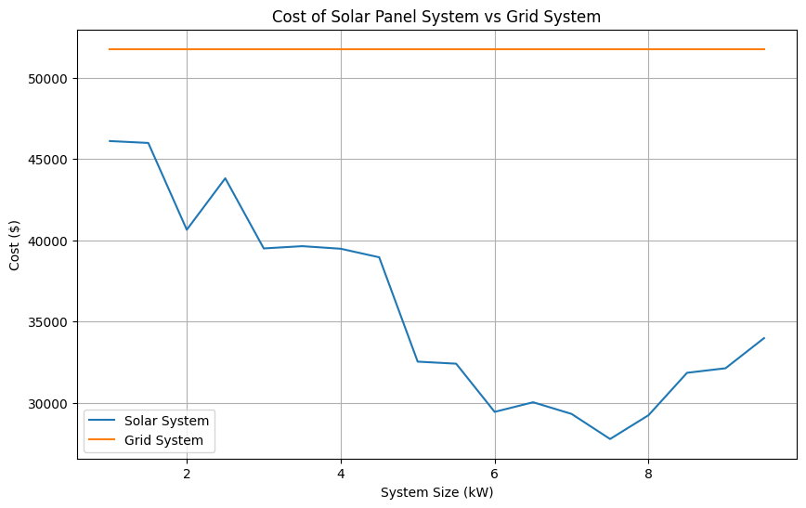
System Size vs. Cost Analysis:
For someone who uses a standard amount of energy, the best amount of KW to install would be between 7 and 8.
However, even installing 1 KW results in overall energy costs significantly cheaper that relying solely on grid power

Slide 10
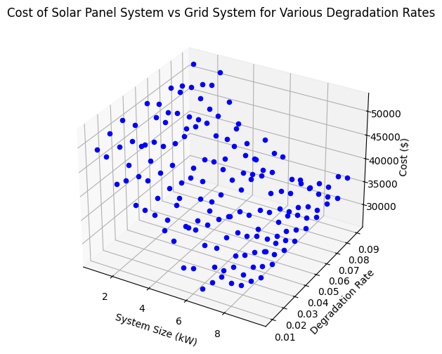
Degradation Rate vs. Cost Analysis:
As the degradation rate for the system increases the total cost of the system obviously does too. This is useful in determining the quality of the panels to buy

Slide 11
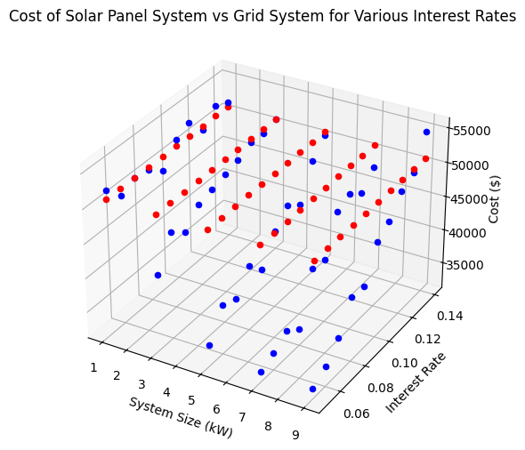
Interest Rate vs. Cost Analysis:
Comparative analysis illustrating the influence of varying interest rates on the financial viability of solar panel systems versus grid systems for residential energy solutions.
Even with extremely high rates, the overall cost remains cheaper than the grid system

Slide 12

Results and findings
Cost Comparison:
Solar Panel Systems are consistently more cost-effective than Grid Powered Systems across various scenarios.
Financing the system at relatively large interest rates (around 15%) still results in lower overall costs compared to grid-based systems.
Purchasing the system outright further reduces costs due to eliminated interest payments.
Impact of Tax Credits:
Significant tax credits from the federal and NY governments play a crucial role in lowering initial costs and enhancing the cost-effectiveness of solar panel systems.
Note: Changes in tax policies can potentially alter these cost dynamics.
Net-Metering Advantage:
Net-metering provides flexibility by allowing excess solar energy to be exported to the grid, offsetting electricity bills during low production periods.
Without net-metering, alternatives like oversized solar installations or expensive battery systems would be necessary, substantially increasing overall system costs.

Slide 13
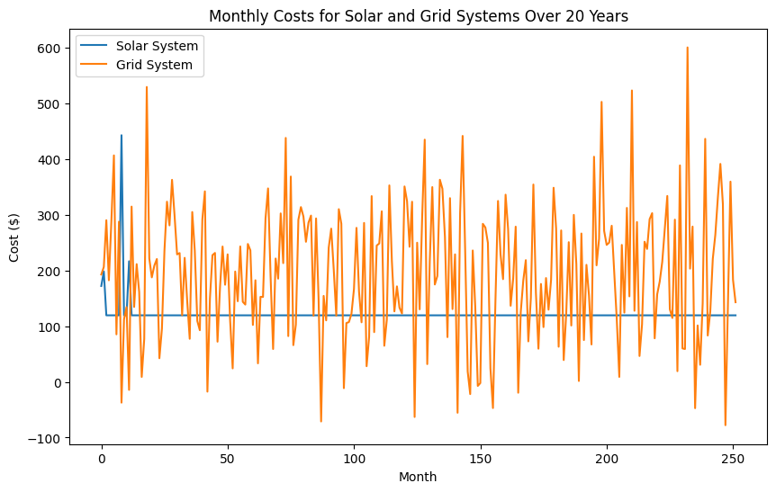
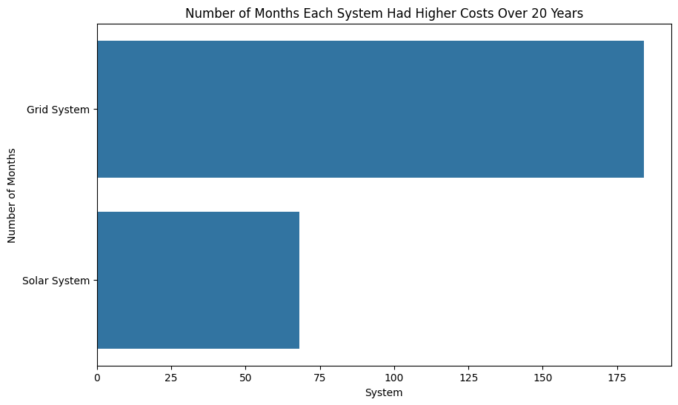
Monthly cost comparison
Financing a 7KW system at a 9% interest rate with rollover net-metering (the current most likely scenario for a NY resident) results in most months having higher costs compared to a grid system.

Slide 14
Verification and validation
Code Reviews:
Conducted thorough code reviews and debugging to ensure the correctness of the implementation.
Peer-reviewed code to identify and correct potential errors or inefficiencies.
Proprietary Solar Calculator Validation:
Used a proprietary solar calculator from a family member who sells solar systems.
Verified that the simulation numbers matched those from the proprietary calculator, ensuring consistency and accuracy.
Electricity Rates by Month:
Verified from New York State Energy Research and Development Authority (NYSERDA)
NYSERDA Electricity Rates
Cost per KW for Solar Panels:
Referenced from EnergySage, providing up-to-date cost estimates for solar panel installations in New York.
EnergySage Solar Panel Costs
Sunlight Hours by Month:
Obtained from FootprintHero, offering precise peak sunlight hours for various locations.
FootprintHero Sunlight Hours

Slide 15
Limitations
Installation costs were simulated a fixed constant – Real world data is always subject to change
Monthly energy usage patterns were simulated based on the mean usage for NYC with a normal distribution – Many users will have varying patterns
This simulation was done using ConEd current rates – Other localities will have different rates
A constant 1.7% increase in energy rates was assumed – Actual increases will vary
A federal tax credit and NY State credit were included in the costs – They can be changed in the future
While degradation rate was swept using DOE, a constant percentage rate was calculated in all instances – Actual degradation will vary from year to year
A 20 year outlook was simulated since many systems are financed that long, many warranties are that long and the degradation at that point can be significant – A paid off system can alter the results tremendously after 20 years.

